Slide 1
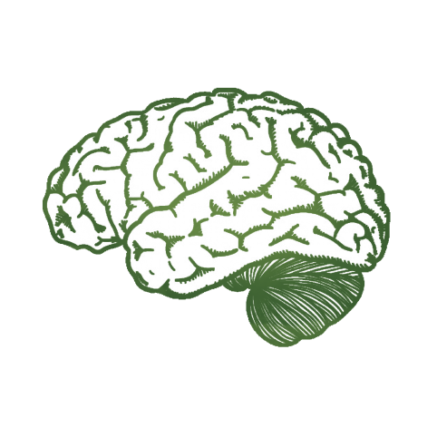
From Many to Many:
Forming the Compassionate Groups
That Can Save the World
Rick Hanson, Ph.D.
Global Compassion Coalition &
UC Berkeley’s Greater Good Science Center
www.RickHanson.net

Slide 2
Sorrow and Hope

Slide 3
Unprecendented Peril . . .
Climate castastrophe
3 billion of us cannot afford a healthy diet
8 men own as much as 4 billion people
Threat of nuclear war
Profit economies crushing well-being
Increasing tools of totalitarian control

Slide 4
. . . And Unparalleled Promise
Growing middle class
Greater power of women
Science, education, internet
Increasing civil society
Widening access to psychological tools
Worldwide, a growing sense of: Enough!

Slide 5
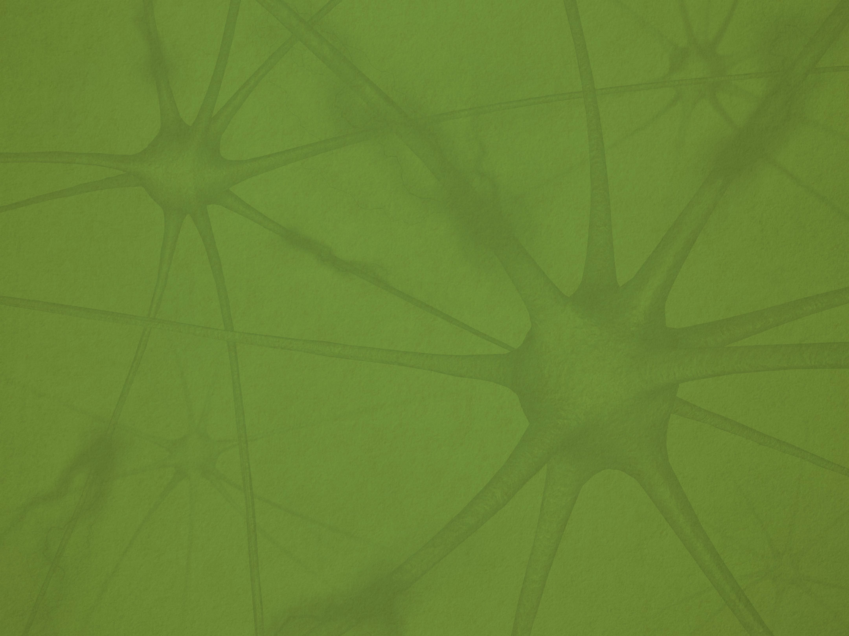
When did you start to feel that
there had to be a better way?

Slide 6
Systemic Causes of Suffering

Slide 7
Compassion opens to suffering,
and brings caring to it,
moved to relieve suffering
and to change its causes.

Slide 8
Throughout history,
much suffering has been caused by
systemic political and economic forces
that served some at the cost of many.
The same is true today.
If compassion is truly to relieve suffering,
it must think big enough to address these forces, not just individual or interpersonal factors.

Slide 9
First fish: Good morning, how’s the water?
Second fish: What’s water?

Slide 10
Here’s the headline:
The way we live today,
the way we’ve lived for the past 10,000 years,
is a vast and suffering-saturated departure from the biological blueprint
we evolved for living together.

Slide 11
Hunter-Gatherer Politics

Slide 12
Humans have walked the earth for 300,000 years.
Until farming-and-herding emerged 10,000 years ago, they lived in small hunter-gatherer bands.
Dependent on each other for raw survival, the foundation of social life was “caring-and-sharing” – compassion and justice – rather than the “holding-and-controlling” of other primate species.

Slide 13
The callousness and cruelty
in holding-and-controlling
still found expression
in frequently violent competition
for scarce resources between bands.

Slide 14
But holding-and-controlling was regulated inside the band by three conditions inherent in hunter-gatherer society.
Imagine spending your days with the same 50 people, few possessions, and your fates bound together – living with:
• Common truth
• Common welfare
• Common justice

Slide 15
Common truth – Day after day in small groups, the facts become obvious. Did the leader’s plan work? Is someone eating more than their share?
Common welfare – What happened for some happened for all. The self-interest of leaders was tied to the good of the group.
Common justice – Leaders had to face their people every day, and face consequences if they mistreated them.

Slide 16
Politics is about decision-making,
sharing resources,
regulating power,
protecting the vulnerable,
and cooperative action.
With our big social brains, a politics for the common good emerged naturally from the three conditions of hunter-gatherer life.

Slide 17
We humans are best able to govern ourselves when:
the truth is readily apparent to all,
the welfare of the few is tied to the welfare of the many,
and leaders face justice for their actions.
This is how we evolved to govern ourselves.
But this is not how our world works today –
and vast suffering is the result.

Slide 18
Concentrated Wealth and Power

Slide 19
In hunter-gatherer bands, there were (and are) hierarchies of wealth and power – though constrained by common truth, welfare, and justice.
But farming-and-herding enabled
growing concentrations of wealth and power –
ending common truth, welfare, and justice . . .
unleashing the primal strategy of
holding-and-controlling inside most societies,
and it’s kind of been Game of Thrones ever since.

Slide 20
Un-common truth – Greed and corruption behind closed doors. Truly fake news spread virally. Attacks on truth-tellers, journalists, and scientists.
Un-common welfare – The good fortune of some is usually separate from the struggles and often poverty of the many.
Un-common justice – “Rich man’s law, poor man’s law.” Governing elites not held to account, and insulated from the people they harm.

Slide 21
The Un-Common Good Today
Half of us live in a dictatorship, just 6% in full democracy
Many inequalities for women and other groups
Children dying of hunger: 10,000 a day, 3+ million a year
Stolen wealth – trillions of dollars – from slavery and colonialism
8% of the world’s people hold 85% of its riches
Political influence is tied to money:
• USA, 2000-2016: fossil fuel industry spent $2 billion against climate action
• Worldwide, $1 trillion in bribes paid each year

Slide 22
I’m not saying that all those with wealth and power
have gained it unfairly or ignored the common good.
Wealthy benefactors have supported wonderful things.
Wise, large-hearted leaders have made great contributions.
Still: wealth and power have been used routinely
throughout history to hide the facts,
decouple private gains from public welfare,
and shield leaders from justice –
all to gain even more wealth and power.

Slide 23
Whew.
So much suffering due to these structural factors.
Take a moment to contemplate it.

Slide 24
What can we do?

Slide 25
Go Big

Slide 26
Our problems are big.
We must do what our ancestors did,
and come together in ways that are
big enough to solve them.

Slide 27
Entrenched interests compete at the marketplace level . . . but cooperate at the political level: spending hundreds of billions of dollars each year to influence policy in both legal and corrupt ways.
Prosocial groups usually do the opposite: friendly with each other at the local level . . . but rarely combining their resources at the political level at a scale that can compete with entrenched interests.

Slide 28
Compassion has been growing worldwide,
typically practiced one-to-one or one-to-many.
Now we need to unleash the power
of many-to-many,
and form a truly global coalition
at the scale of the whole human tribe.

Slide 29
So we’ve established the Global Compassion Coalition for the science, education, application, and advocacy of compassion, with a Board, Advisory Council, and key staff.
Mission: Restoring compassion and justice
in the foundation of all societies
Purposes:
• Help our members do what they do even better
• Drive influence campaigns in our culture and politics
• Pursue a flagship project – ending child hunger? capping climate change? – that also builds civil society

Slide 30
We’re launching in 2023, which will include:
• major website
• compassion+ information, symposia, projects
• regular newsletter/magazine
• developing a Compassion Index
• facilitating micro-grants for researchers and activists
• the first annual Compassion Prizes
• the first annual Festival of Compassion
• moving toward the influence campaign and flagship project
• and much, much more

Slide 31
January, 2023 will have our formal launch –
but before then we’d love you to join this growing coalition!
To learn more,
go to www.GlobalCompassionCoalition.org.

Slide 32
Go Wide

Slide 33
Neuropsych Benefits of a Wider View
Draws us into the present
Relaxes the contracted “me, myself, and I”
Calms stressful “doing,” and strengthens the sense of “being”
Brings in useful information
Fosters a sense of connectedness with all things –
including others in common cause

Slide 34
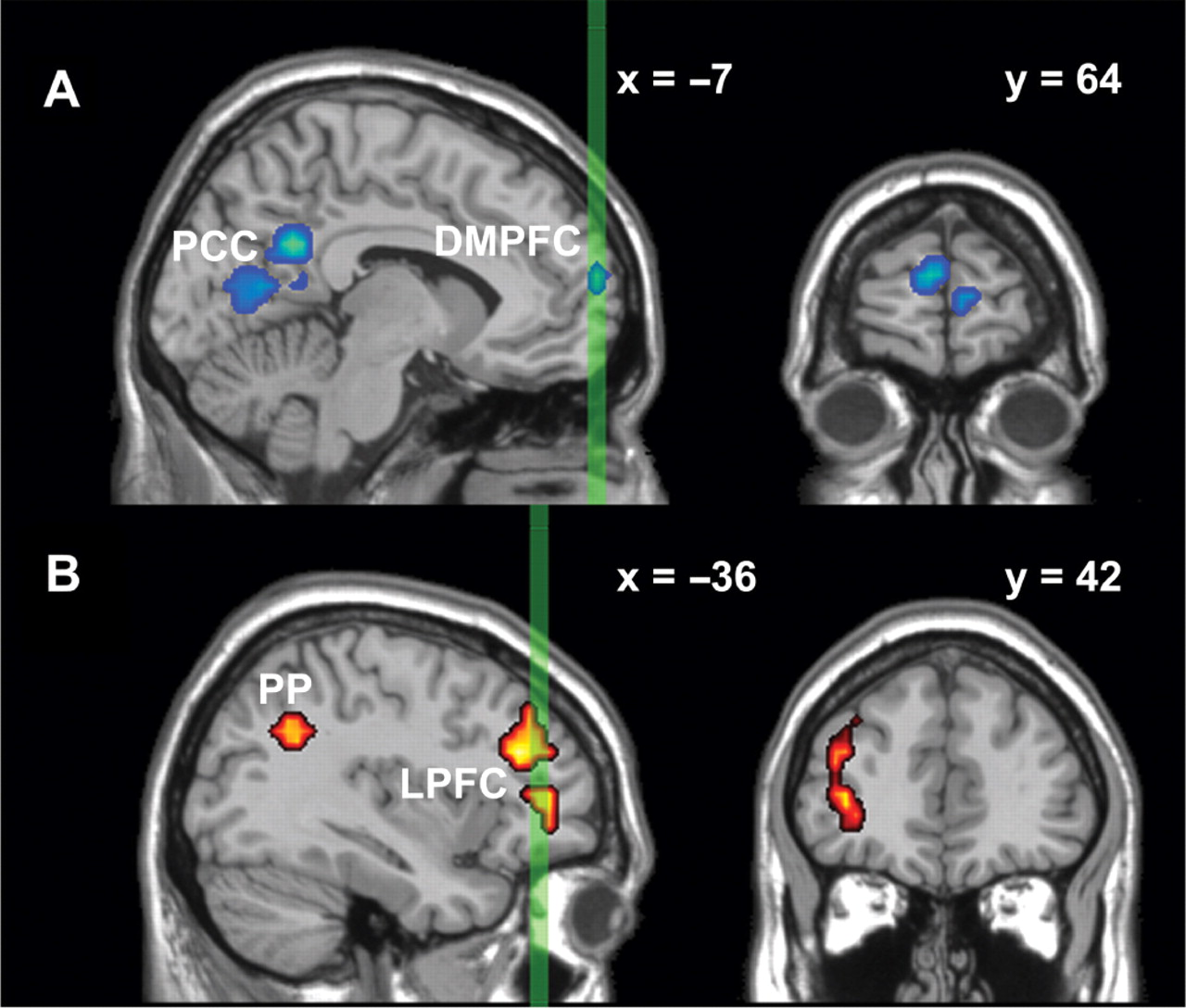
Self-Focused (blue) and Open Awareness (red)
Farb, et al. 2007. Social Cognitive Affective Neuroscience, 2:313-322

Slide 35
Remember:
Our biological nature is to care and to share, grounded in the truth of living together,
creating societies that work for all of us.
Then the “three fuels of the fires of suffering” – hatred, greed, and delusion – are greatly reduced.
This is the normal human condition.
Mother Nature is on our side!

Slide 36
It is the abnormal,
pathological, systemic structures
of holding-and-controlling
that have fueled those fires for 10,000 years.
We just have to get normal again!

Slide 37
Most of the people
who maintain those abnormal structures today
are unaware of the full consequences
of their roles and decisions.
But their incentives maintain the status quo.

Slide 38
To change those incentives,
the evolution of altruism contains great lessons:
• Foster common truth about what’s happening
• Value common welfare and common justice
• Provide benefits for caring-and-sharing
• Have costs for holding-and-controlling

Slide 39
At the personal level:
you can know what you see,
what you value,
and what you plan as a result . . .
without being invaded by
righteousness and hostility.

Slide 40
At the systemic level:
we can recognize structural sources of suffering
and the incentives that perpetuate them,
and we can value a world that – for example – halts global warming at “just” 2 degrees Celsius,
and we can act effectively to change those systemic sources of suffering . . .
while not making others into enemies.

Slide 41
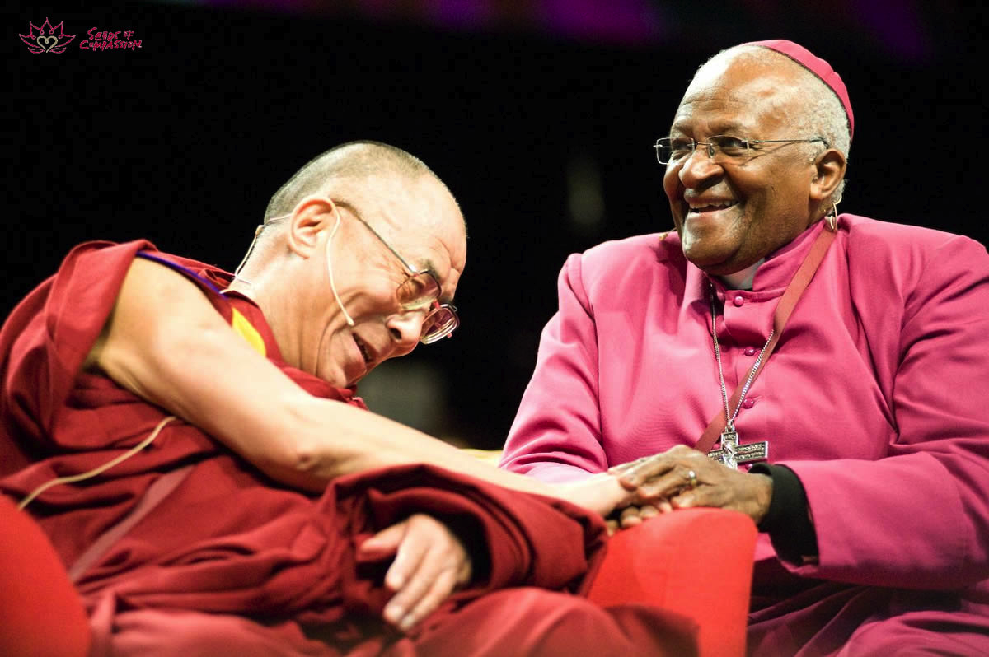

Slide 42
Go Long

Slide 43
It took 10,000 years to get here,
and it will take a while to get to a better place.
This long view is realistically hopeful,
since it is steady effort over time
that will establish compassion
at the heart of global society.

Slide 44
Big Change 2100
What are your realistic hopes for the end of this century?
No child is hungry, neglected, or abused?
Global warming capped at 3 degrees Fahrenheit?
Everyone living in civil society?
All children educated, not just some boys?
Humanity living in harmony with its precious home planet?

Slide 45
Compassion calls us to nothing less . . .
. . . and we’ve got a big job ahead!

Slide 46
To stay the course, we need to grow
courage and hope,
love and clear seeing,
and common cause for the common good.

Slide 47
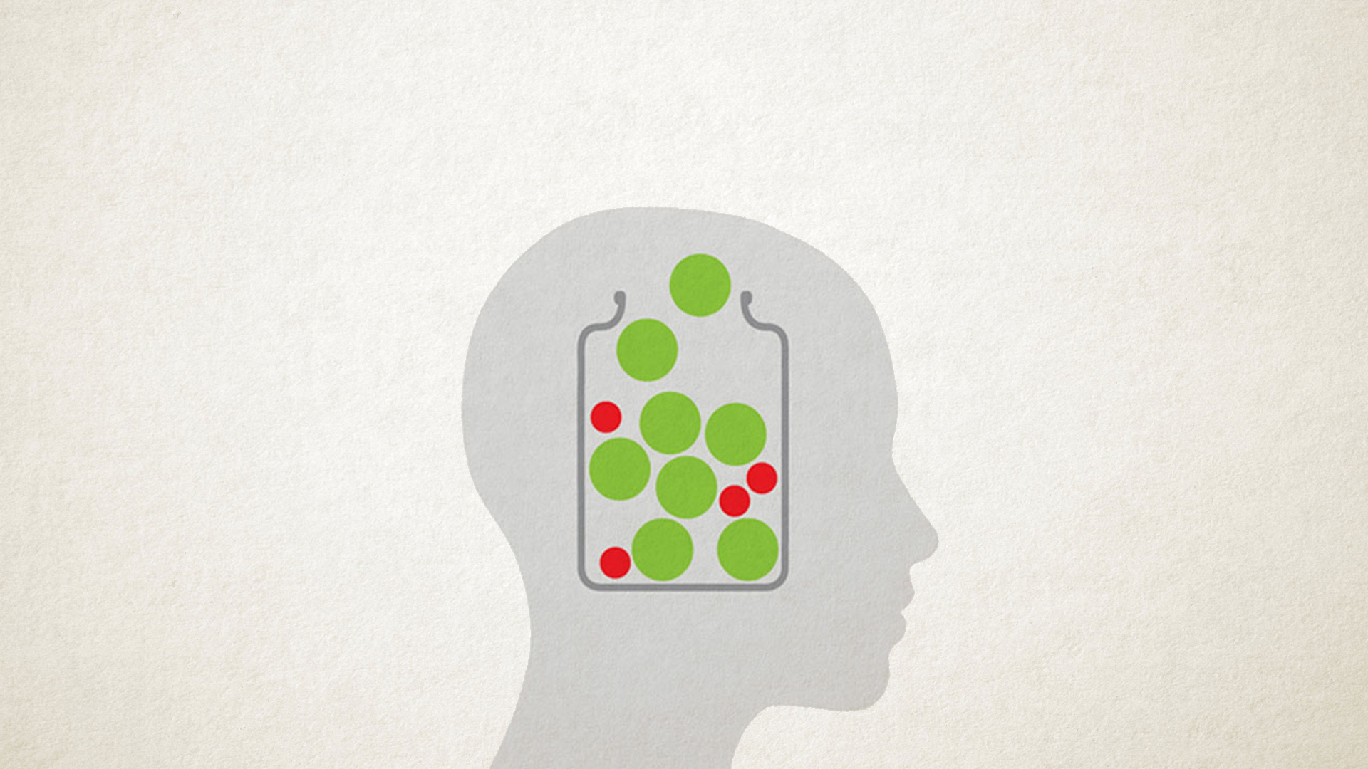
Which Means Changing Your Brain
For the Better

Slide 48
So let’s take a few moments
to rest in the sense of this:
courage
hope
love
clear seeing
and common cause for the common good.

Slide 49
Each of us has been loved into being
by one or more people.
In the same way, we can love others into being.
And by joining together at the global scale
we can love into being
the world that we long for
with compassion at its heart.

Slide 50
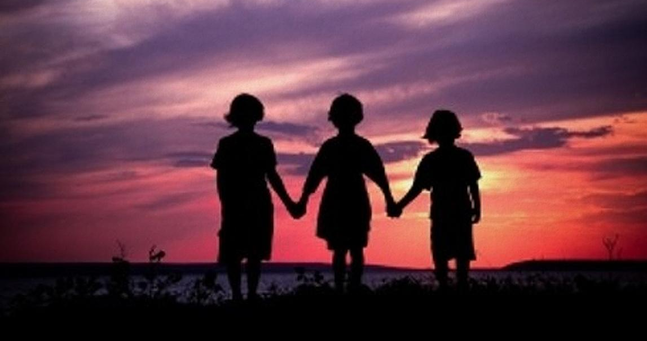
Thank You

